Slide 1
MediaWiki for OER and Learning Analytics Understanding learning resources, and learners
Simon Knight
user:sjgknight – vice chair Wikimedia UK
@sjgknight,
http://sjgknight.com
Notes:
Philosophy & psychology (i.e. not particularly techy), MA in phil of ed, Mphil in research methods in ed, PGCE in social sciences (taught for a year), PhD at KMi in learning analytics

Slide 2
Open Educational Resources
Open Educational Resources (OER) – learning materials for free use and reuse
Notes:
http://en.wikipedia.org/wiki/Open_educational_resources
http://en.wikipedia.org/wiki/File:Logo_OER.png
Note the wikiversity logo is NOT CC licence (http://en.wikipedia.org/wiki/File:Wikiversity-logo-en.svg)
http://wikieducator.org/Learning4Content

Slide 3
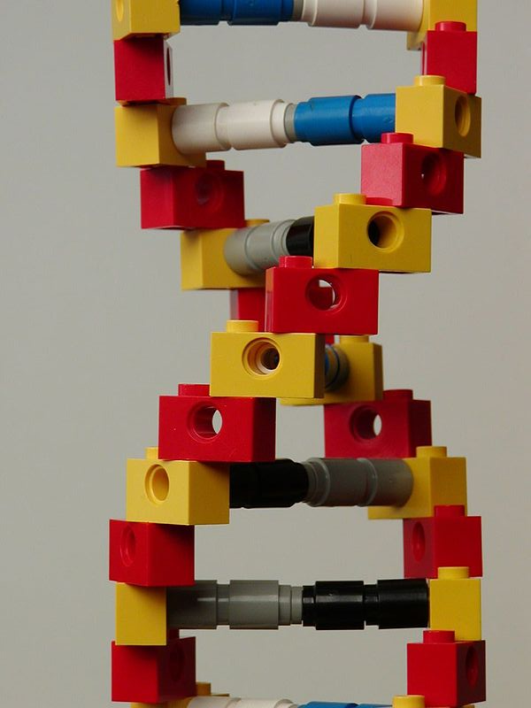
Open in OER
Mediawiki provides facility for:
Verbatim reuse (copy or transclude)
Adaptation (of the page, or versioning)
Remixing (combine bits of content, through transclusion or copying)
Redistribute (widely available platform, export options to PDF, etc. )
http://commons.wikimedia.org/wiki/File:Lego_DNA.jpg
Notes:
http://opencontent.org/definition/
http://commons.wikimedia.org/wiki/File:Lego_DNA.jpg – CC BY/generic

Slide 4
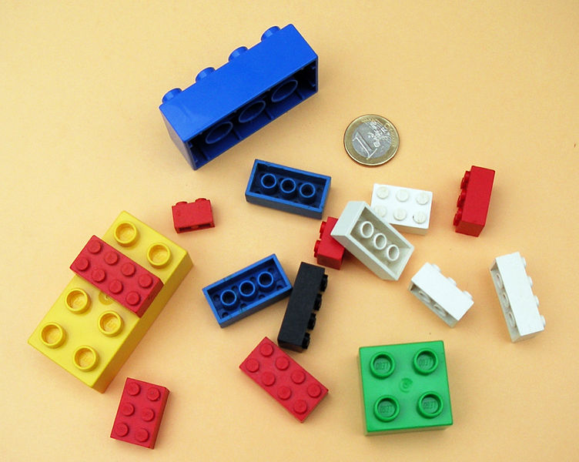
OER & Paradata
Paradata – track use, not just hit counters but favourites, tags, linked content, etc. User characteristics also inform.
Notes:
http://commons.wikimedia.org/wiki/File:LEGO-01.jpg – public domain
http://en.wikipedia.org/wiki/Paradata_%28learning_resource_analytics%29
CETIS report http://publications.cetis.ac.uk/2013/808
https://github.com/edsu/linkypedia/wiki “The idea behind linkypedia is to help cultural heritage institutions that are putting content online to see how wikipedians are citing and annotating their stuff.”
File usage
The following pages on the English Wikipedia link to this file (pages on other projects are not listed):
Open educational resources
User:Daniel Mietchen/Talks/Arbeitskreis Helmholtz-Pressesprecher/Options for collaboration between the Helmholtz Association of German Research Centres and Wikimedia
User:Daniel Mietchen/Talks/Open Access in Poland 2012/Reuse of Open Access materials
User:Daniel Mietchen/Talks/Turkic Wikimedia Conference 2012/Reuse of Open Access materials
User:Daniel Mietchen/Talks/World Open Educational Resources Congress 2012/How Open Access and Open Science can mutually fertilize with Open Educational Resources
User:Daniel Mietchen/Talks/World Open Educational Resources Congress 2012/Licensing
Wikipedia talk:Articles for creation/Open Educational Resources (OER) Logo
Global file usage
The following other wikis use this file:

Slide 5
The learner side – who is interacting, and how?
learning analytics is “the measurement, collection, analysis and reporting of data about learners and their contexts, for purposes of understanding and optimising learning and the environments in which it occurs” (LAK11) – in informal, and formal learning contexts (LAK12)
Notes:
http://commons.wikimedia.org/wiki/File:DNA_Lego_Model.jpg

Slide 6
Why, What, How of LA
Why – we can capture data on/offline, if we can use this support students so much the better
What – attendance, social network/interactions, discourse analytics, dispositional analytics, grades, etc.
How – user submitted, learning platform trace (mediawiki, moocs, VLEs, etc.)

Slide 7
Supporting Open Educational Practices?
Referencing
Interacting with community
Understanding Neutral Point of View

Slide 8
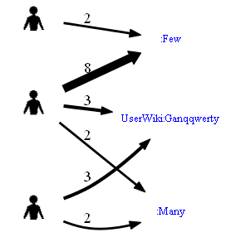
WikiLytics
WikiTrust
Collaboration Diagram (& deeper metrics)
Edit counts (or, edit size, or time spent editing)
Feedback Tool (with actions – “To improve the trustwothyness…”)
Notes:
http://en.wikipedia.org/wiki/WikiTrust
Wikimetrics https://www.socialtext.net/open/wiki_metrics
StatMediaWiki http://statmediawiki.forja.rediris.es/manual_en.html
http://people.kmi.open.ac.uk/knight/2013/01/mediawiki-for-learning-analytics/
http://people.kmi.open.ac.uk/knight/2013/05/collaborative-information-seeking-on-wikipedia-talk-pages/

Slide 9
LA for paradata
OER Potential:
What learner skills do you need to access this resource?
Who can help you with this resource?
What will you learn from this resource?
How can you contribute to this community?
What pathways do similar learners take to this resource?
Notes:
paradata may facilitate ‘linkedup’ OER – for personalised, connected learning repositories http://www.nominettrust.org.uk/knowledge-centre/blogs/finding-knowledge-linking-open-educational-resources

Slide 10
MediaWiki for OER and Learning Analytics Understanding learning resources, and learners
Simon Knight @sjgknight, user:sjgknight
http://sjgknight.com

Slide 11
Intro to paradata/reflection on EduWiki conference http://www.nominettrust.org.uk/knowledge-centre/blogs/wikipedia-education-and-tracking-how-knowledge-used
paradata may facilitate ‘linkedup’ OER – for personalised, connected learning repositories http://www.nominettrust.org.uk/knowledge-centre/blogs/finding-knowledge-linking-open-educational-resources
Some ways of tracking open content in the wild – this is a key challenge for CC licence, measuring ‘impact’ http://www.nominettrust.org.uk/knowledge-centre/blogs/measuring-impact-tracking-open-content-wild
OGL licence content and issues with PDFs http://www.nominettrust.org.uk/knowledge-centre/blogs/creative-commons-open-government-licensing-and-pdfs

Slide 12
Mediawiki context
http://en.wikivet.net/Veterinary_Education_Online
http://edfutures.net/Main_Page and http://edutechwiki.unige.ch/en/Main_Page
http://sjgknight.com/finding-knowledge/2013/01/mediawiki-for-learning-analytics/

